Slide 1
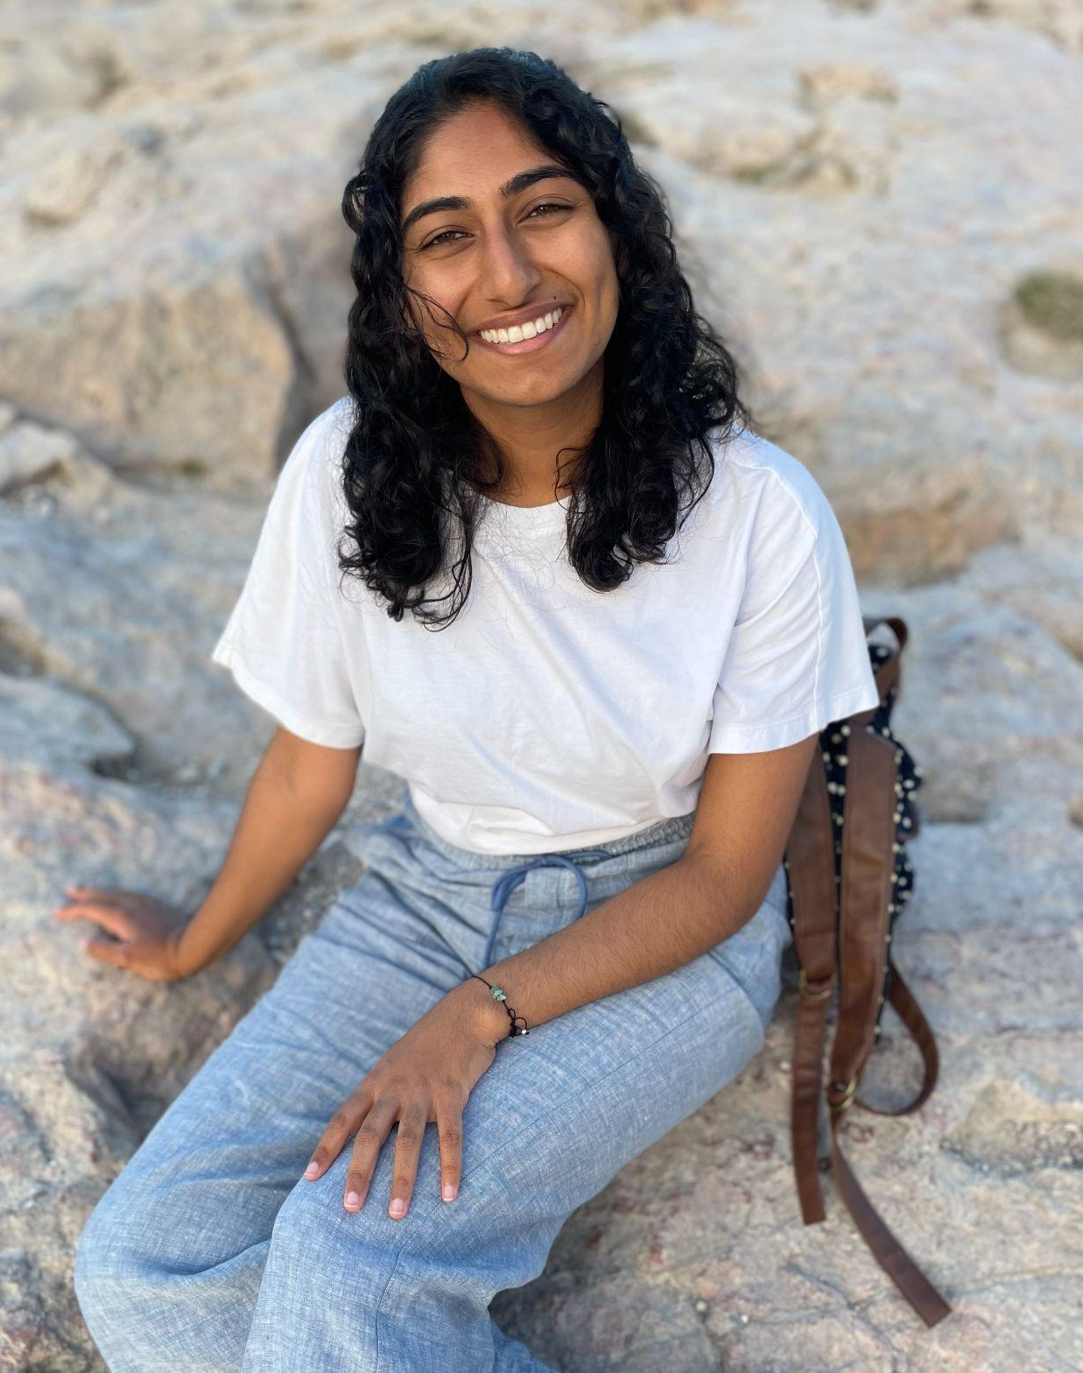
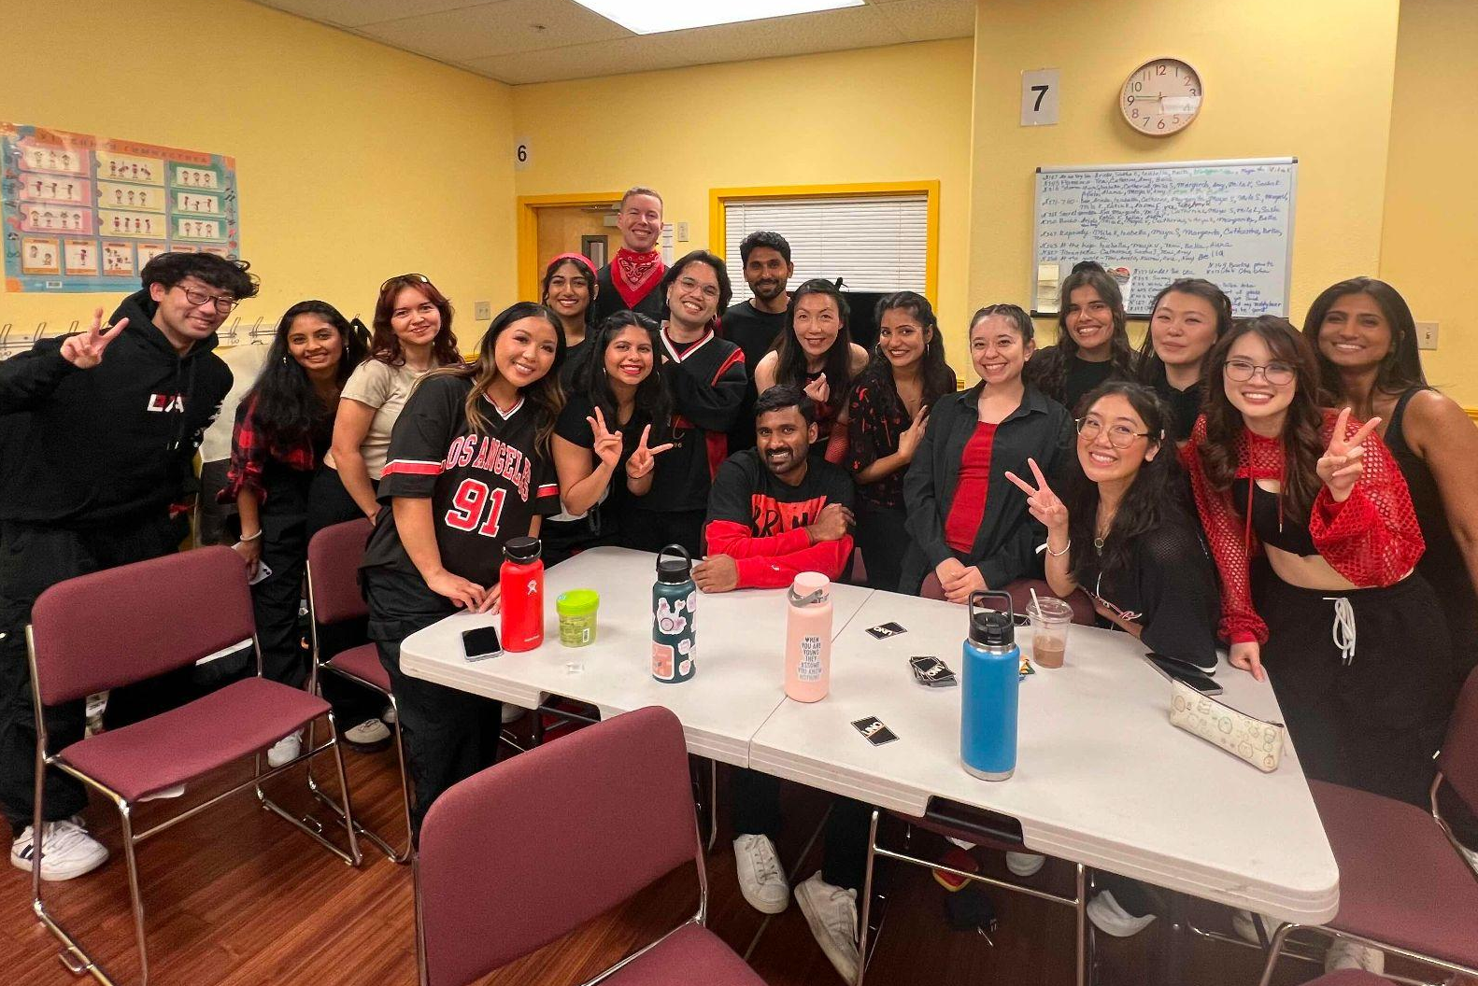
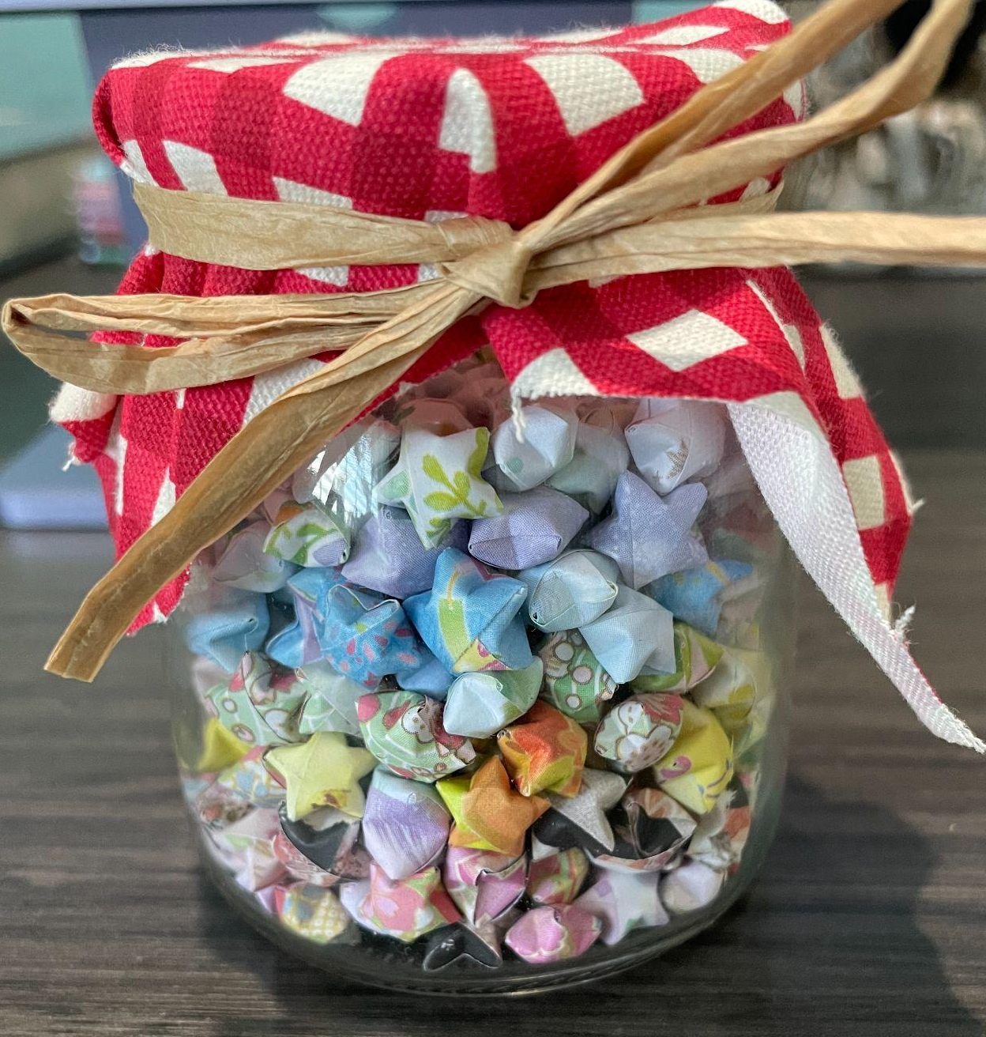
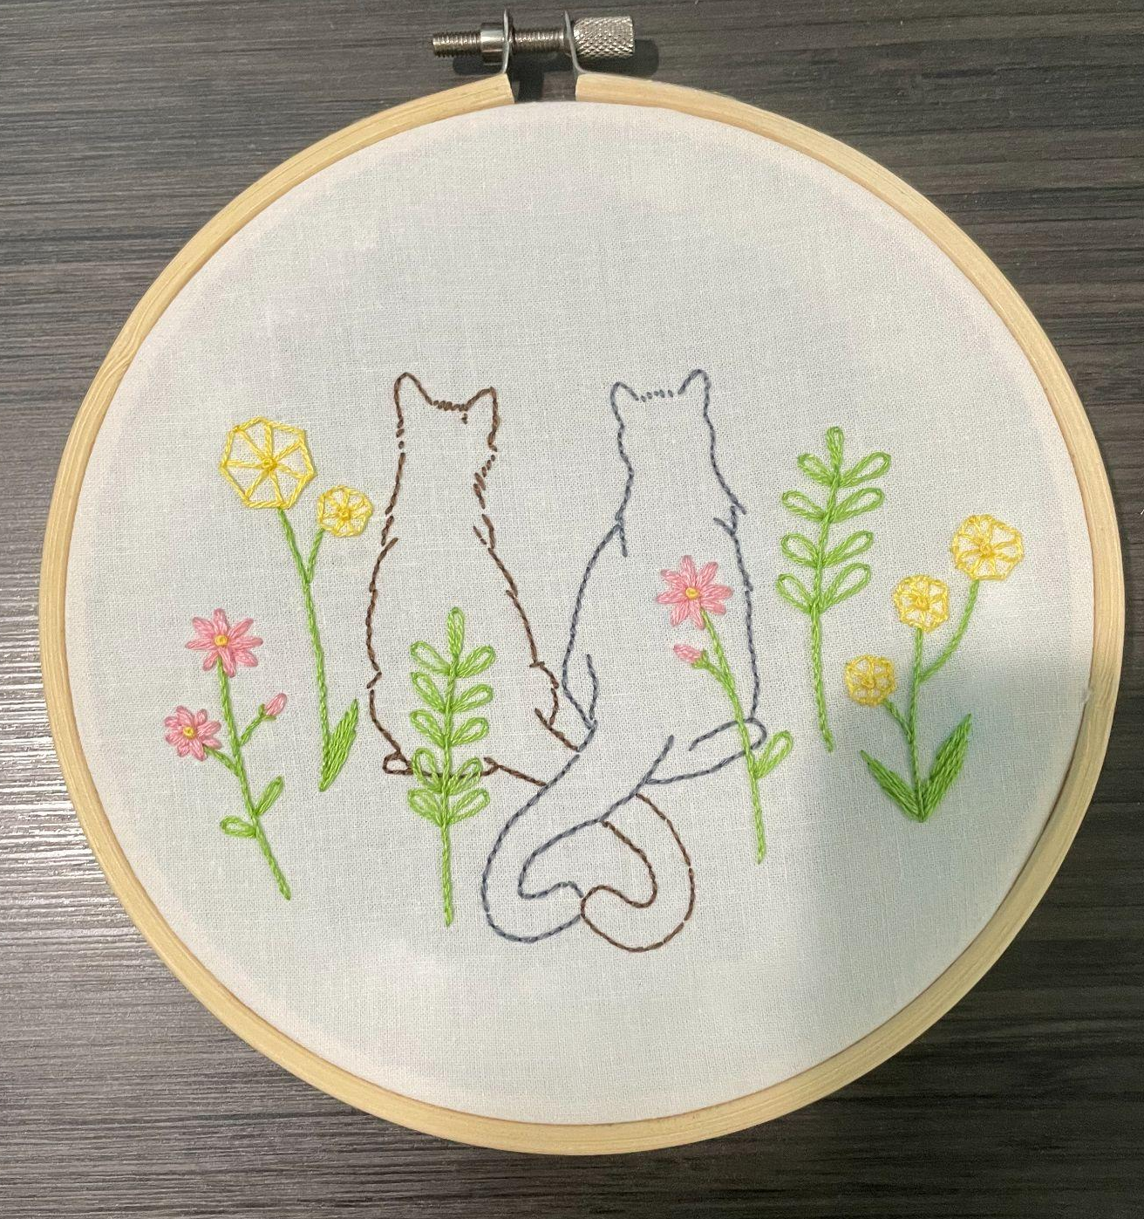
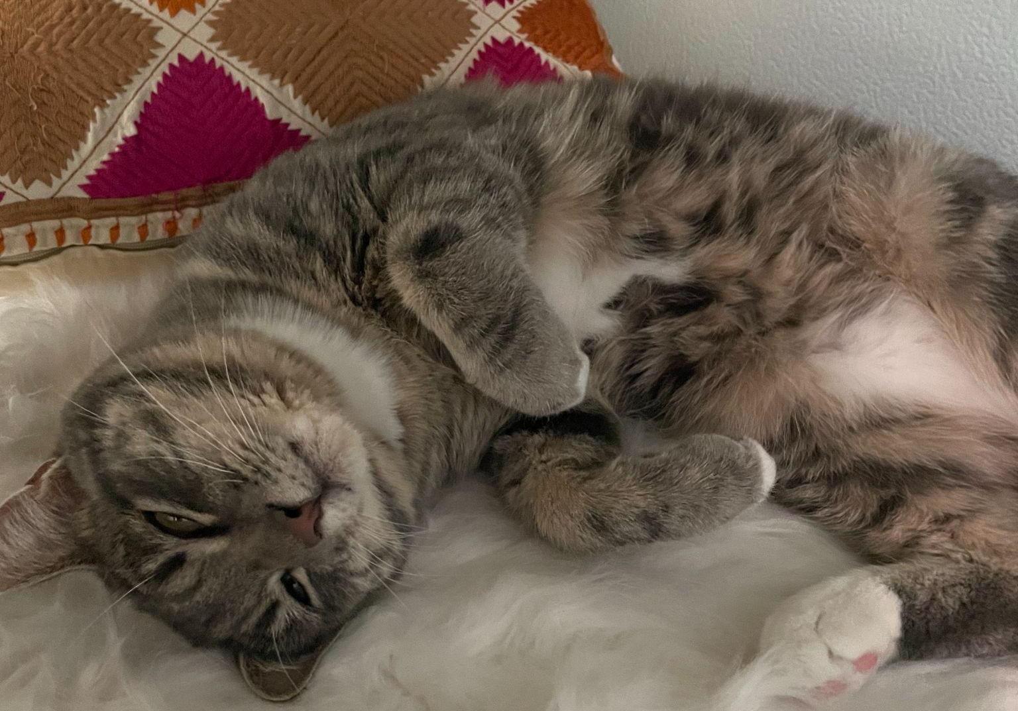
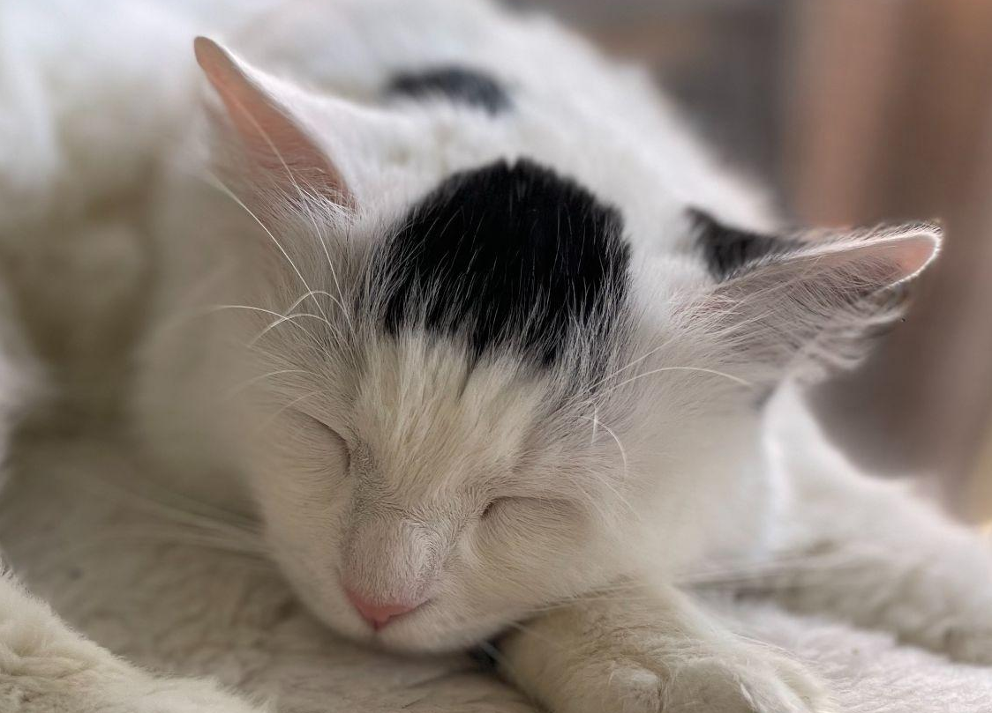
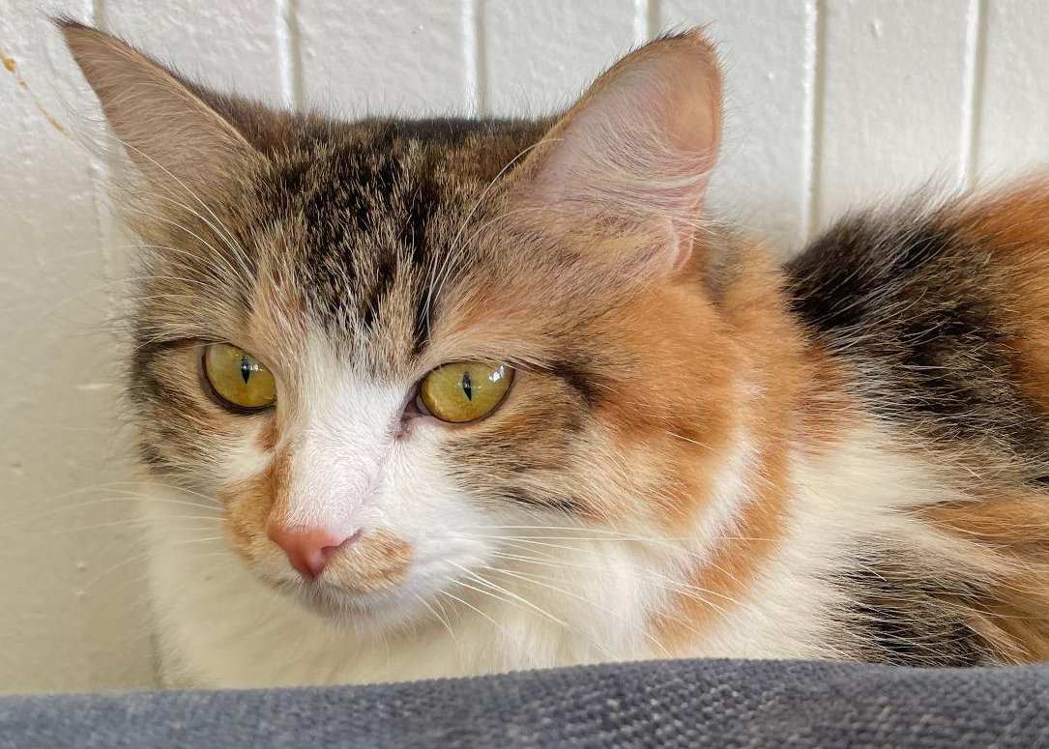
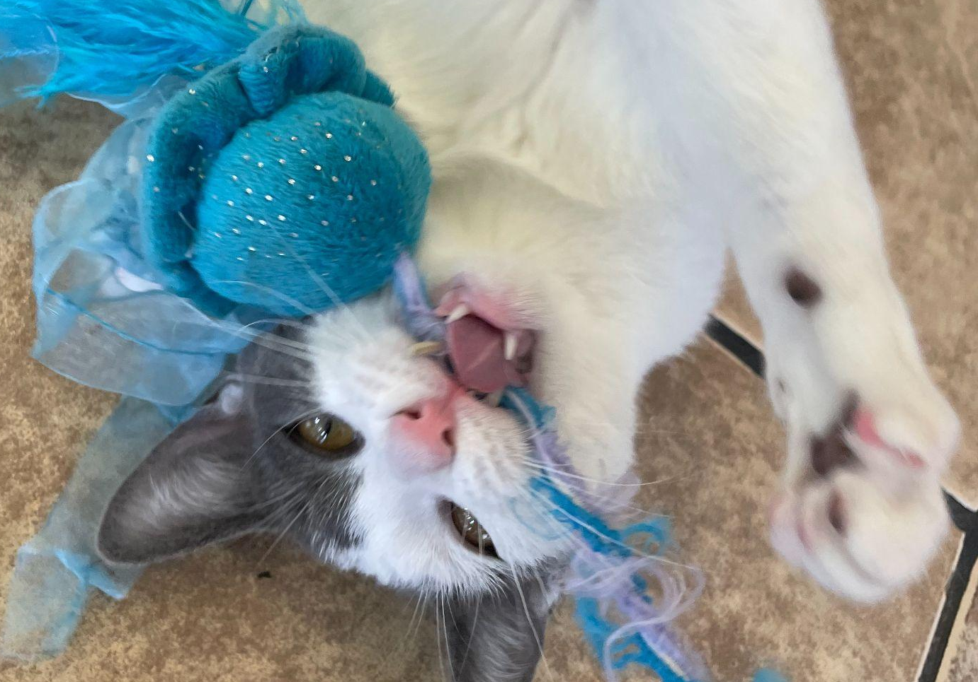
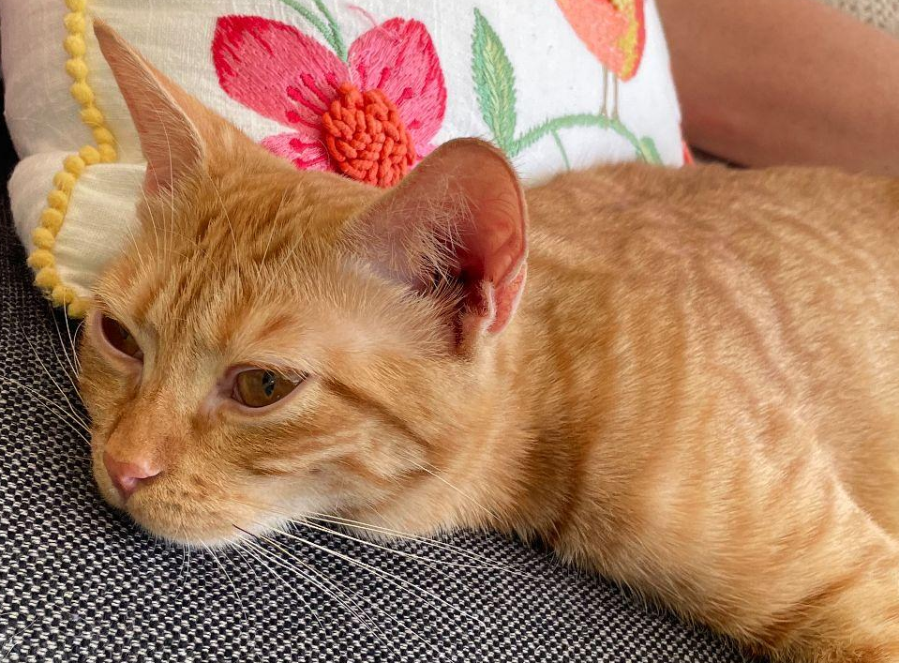
Radha Ganesh
My mentor is Dr. Barbara Novak, and my project is about identifying best practices for deduplication of bulk RNAseq datasets both with and without Unique Molecular Identifiers (UMIs).
In my free time, I love dancing, crafting, going to cafes, and volunteering at a cat shelter.
my dance team
my latest craft projects
some of the cats I volunteer with

